Slide 1
Lead Scoring Case Study
SUBMISSION REPORT
To build a Logistic Regression Model to predict whether a lead for online courses for an education company named X Education would be successfully converted or not.
Group Members
:
Shaik shaikshavali
Jhon Mathew

Slide 2



Business Objective
To help X Education to select the most promising leads(Hot Leads), i.e. the leads that are most likely to convert into paying customers.
To build a logistic regression model to assign a lead score value between 0 and 100 to each of the leads which can be used by the company to target potential leads.
The objective is thus classified into the following sub-goals:
Create a Logistic Regression model to predict the Lead Conversion probabilities for each lead.
Decide on a probality threshold value above which a lead will be predicted as converted, whereas not converted if it is below it.
Multiply the Lead Conversion probability to arrive at the Lead Score value for each lead.

Slide 3



Problem
The approach for this project has been to divide
Solving Methodology
the entire case study into various checkpoints to meet each of the sub-goals. The checkpoints are represented in a sequential flow as below:
Understanding the Data Set & Data Preparation
Applying Recursive feature elimination to identify the best performing subset of features for building the model.
Building the model with features selected by RFE. Eliminate all features with high p-values and VIF values and finalize the model
Use the model for prediction on the test dataset and perform model evaluation for the test set.
Decide on the probability threshold value based on Optimal cutoff point and predict the dependent variable for the training data.
Perform model evaluation with various metrics like sensitivity, specificity, precision, recall, etc.

Slide 4

The following data preparation processes were applied to make the data dependable so that it can provide significant business value by improving Decision Making Process:
Remove columns which has only one unique value
Deleting the following columns as they have only one unique value and hence cannot be responsible in predicting a successful lead case – ‘Magazine’, ‘Receive More Updates About Our Courses’ , ‘Update me on Supply Chain Content’ , ‘Update me on Supply Chain Content’ and ‘I agree to pay the amount through cheque’.
Removing rows where a particular column has high missing values
‘Lead Source’ is an important column for analysis. Hence all the rows that have null values for it were dropped.
Imputing NULL values with Median
The columns ‘TotalVisits’ and ‘Page Views Per Visit’ are continuous variables with outliers. Hence the null values for these columns were imputed with the column median values.
Imputing NULL values with Mode
The columns ‘Country’ is a categorical variable with some null values. Also majority of the records belong to the Country ‘India’. Thus imputed the null values for this with mode(most occuring value). Then binned rest of category into 'Outside India‘.

Slide 5

Handling 'Select' values in some columns
There are some columns in dataset which have a level/value called 'Select'. This might have happened because these fields in the website might be non mandatory fields with drop downs options for the customer to choose from. Amongst the dropdown values, the default option is probably 'Select' and since these aren't mandatory fields, many customer might have have chosen to leave it as the default value 'Select'.
The Select values in columns were converted to Nulls.
Assigning a Unique Category to NULL/SELECT
values
All the nulls in the columns were binned into a separate column ‘Unknown’.
Instead of deleting columns with huge null value percentage(which results in loss of data), this strategy adds more information into the dataset and results in the change of variance.
The Unknown levels for each of these columns will be finally dropped during dummy encoding.
The outliers present in the columns 'TotalVisits‘ & 'Page Views Per Visit‘ were finally removed based on iterquatile range analysis.
Outlier Treatment
Converting the following binary variables (Yes/No) to 0/1:
'Search','Do Not Email', 'Do Not Call', 'Newspaper Article', 'X Education Forums', 'Newspaper', 'Digital Advertisement','Through Recommendations‘ and 'A free copy of Mastering The Interview'
Binary Encoding

Slide 6

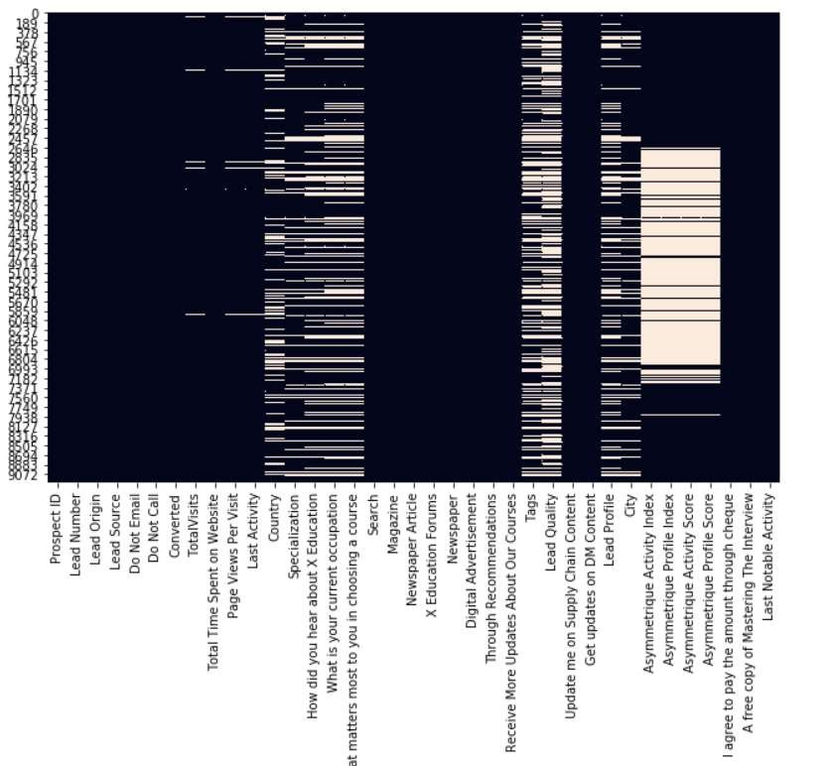
For the following categorical variables with multiple levels, dummy features (one-hot encoded) were created:
'Lead Quality','Asymmetrique Profile Index','Asymmetrique Activity Index','Tags','Lead Profile', 'Lead Origin','What is your current occupation', 'Specialization', 'City','Last Activity', 'Country‘ and 'Lead Source','Last Notable Activity'
Dummy Encoding
Test- Train Split
The original dataframe was split into train and test dataset. The train dataset was used to train the model and test dataset was used to evaluate the model.
Scaling helps in interpretation. It is important to have all variables(specially categorical ones which has values 0 and
on the same scale for the model to be easily
interpretable.
‘Standardisation’ was used to scale the data for modelling. It basically brings all of the data into a standard normal distribution with mean at zero and standard deviation one.
Feature Scaling
Distribution of NULL values in the different columns of the original dataset before null-handling.

Slide 7

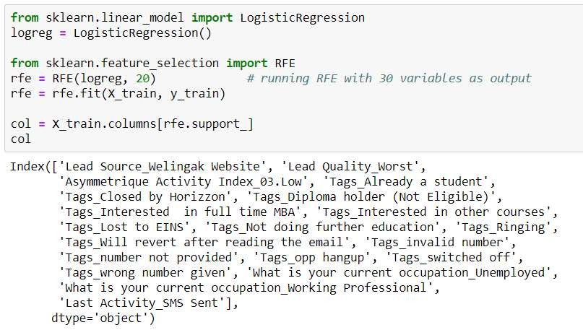
Recursive feature elimination is an optimization technique for finding the best performing subset of features. It is based on the idea of repeatedly constructing a model and choosing either the best (based on coefficients), setting the feature aside and then repeating the process with the rest of the features. This process is applied until all the features in the dataset are exhausted. Features are then ranked according to when they were eliminated.
Running RFE with the output number of the variable equal to 20.

Slide 8


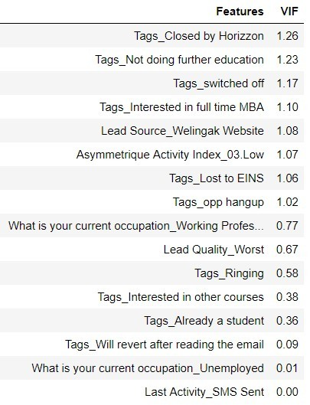
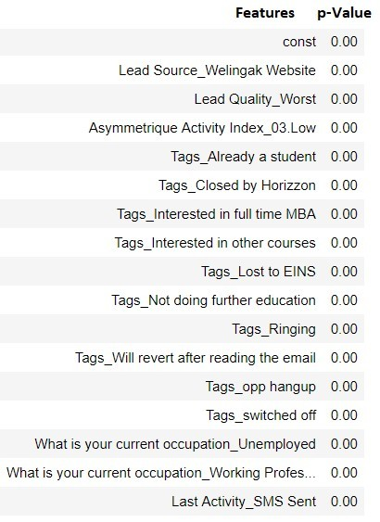
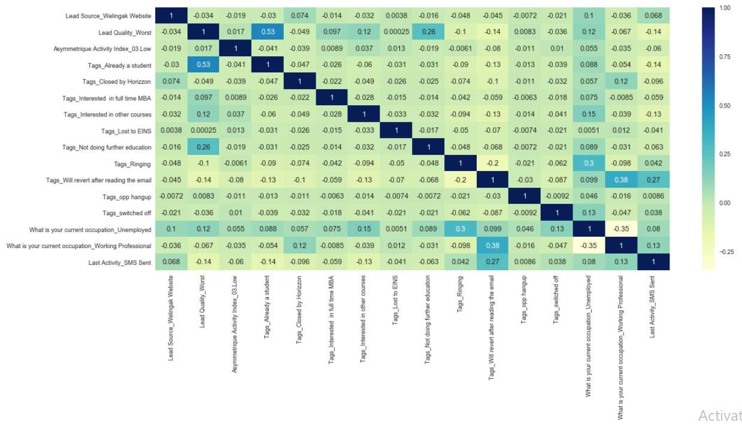
Generalized Linear Models from StatsModels is used to build the Logistic Regression model.
The model is built initially with the 20 variables selected by RFE.
Unwanted features are dropped serially after checking p values (< 0.5) and VIF (< 5) and model is built multiple times.
The final model with 16 features, passes both the significance test and the multi-collinearity test.
A heat map consisting of the final 16 features proves that there is no significant correlation between the independent variables.

Slide 9

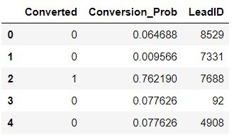
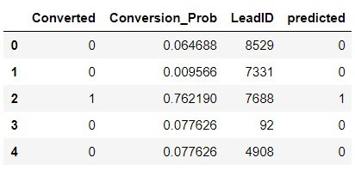
Creating a dataframe with the actual Converted flag and the predicted probabilities.
Showing top 5 records of the dataframe in the picture on the right.
Creating new column 'predicted' with 1 if Conversion_Prob > 0.5 else 0
Showing top 5 records of the dataframe in the picture on the left.

Slide 10

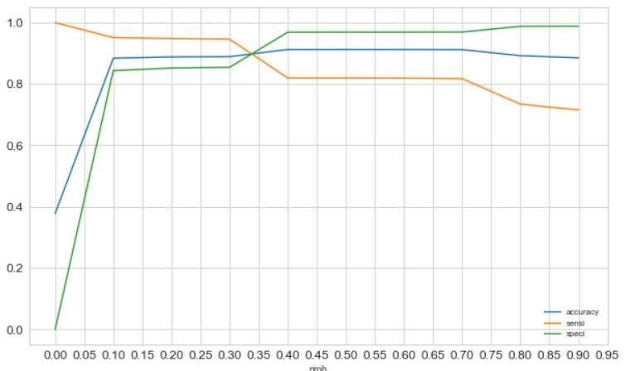
Optimal Probability Threshold
Optimal cutoff probability is that prob where we get balanced sensitivity and specificity.
The accuracy sensitivity and specificity was calculated for various values of probability threshold and plotted in the graph to the right.
From the curve above, 0.33 is found to be the optimum point for cutoff probability.
At this threshold value, all the 3 metrics - accuracy sensitivity and specificity was found to be well above 80% which is a well acceptable value.

Slide 11
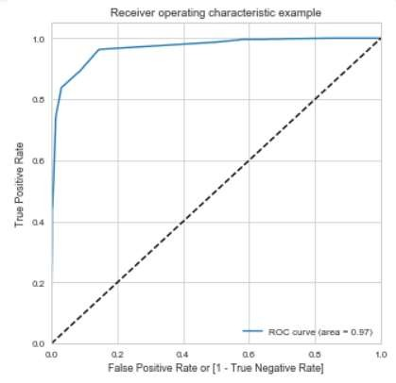
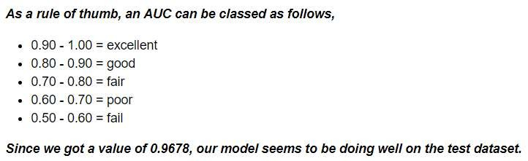
Receiver Operating Characteristics (ROC) Curve
It shows the tradeoff between sensitivity and specificity (any increase in sensitivity will be accompanied by a decrease in specificity).
By determining the Area under the curve (AUC) of the ROC curve, the goodness of the model is determined. Since the ROC curve is more towards the upper-left corner of the graph, it means that the model is very good. The larger the AUC, the better will is the model.
The value of AUC for our model is 0.9678.
Area under the Curve (GINI)

Slide 12

Confusion Matrix
Probability Threshold
= 0.33
# Predicted # Actual
Not Converted
Converted
Not Converted | 3411 | 325
Converted | 256 | 2010
Accuracy
TP +TN/ (TP+TN+FN+FP)
Sensitivity TP / (TP+FN)
Specificity TN / (TN+FP)
False Positive Rate
FP/ (TN+FP)
Positive Predictive Value TP / (TP+FP)
0.903
0.887
0.913
0.087
0.860
Negative Predictive Value TN / (TN+ FN)
F1 score = 2×(Precision*Re call)/(Precision+ Recall)
Area under the cuve
Precision TP / TP + FP
Recall TP / TP + FN
0.930
0.861
0.887
0.874
0.962

Slide 13

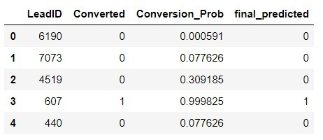
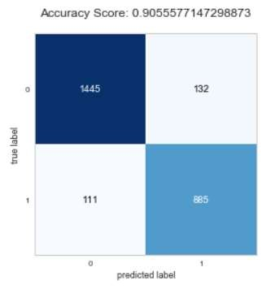
The final model on the train dataset is used to make predictions for the test dataset
The train data set was scaled using the scaler.transform function that was used to scale the train dataset.
The Predicted probabilities were added to the leads in the test dataframe.
Using the probability threshold value of 0.33, the leads from the test dataset were predicted if they will convert or not.
The top 5 records from the final test data set
The Conversion Matrix was calculated based on the Actual and Predicted ‘Converted’ columns.

Slide 14

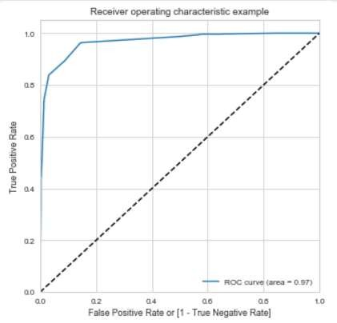
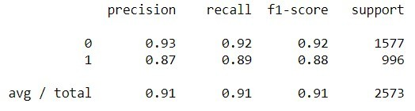
Area under the Curve
The following evaluation metrices were recorded for the test dataset.
Accuracy
TP +TN/ (TP+TN+FN+FP)
Sensitivity TP / (TP+FN)
Specificity TN / (TN+FP)
Area under the cuve
0.906
0.889
0.916
0.968
Negative Predictive Value TN / (TN+ FN)
Precision TP / TP + FP
Recall TP / TP + FN
F1 score = 2×(Precision*Re call)/(Precision+ Recall)
0.928
0.870
0.889
0.879
Classification Report
False Positive Rate
FP/ (TN+FP)
Positive Predictive Value TP / (TP+FP)
Cross Validation Score
0.084
0.870
0.913

Slide 15

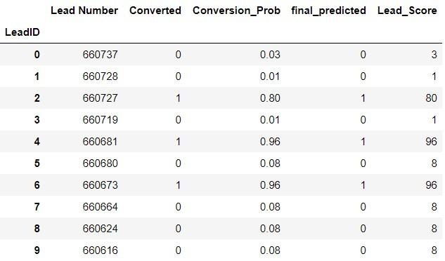
Lead Score is calculated for all the leads in the original dataframe.
Formula for Lead Score calculation is:
Lead Score = 100 * Conversion Probability
The train and test dataset is concatenated to get the entire list of leads available.
The Conversion Probability is multiplied by 100 to obtain the Lead Score for each lead.
Higher the lead score, higher is the probability of a lead getting converted and vice versa,
Since, we had used 0.33 as our final Probability threshold for deciding if a lead will convert or not, any lead with a lead score of 34 or above will have a value of ‘1’ in the final_predicted column.
The figure showing Lead Score for top 10 records from the data set.

Slide 16

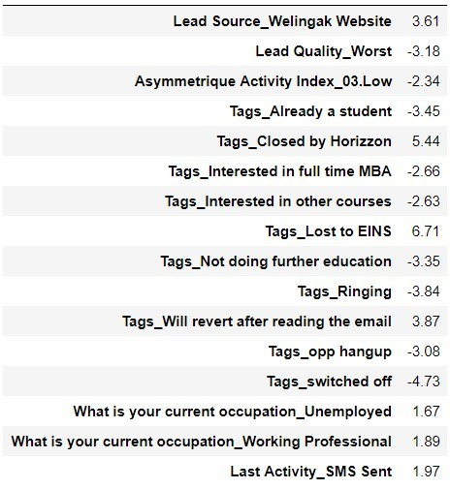
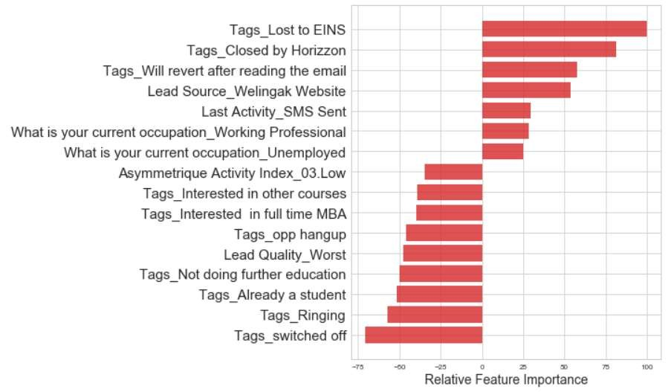

16 features have been used by our model to successfully predict if a lead will get converted or not.
The Coefficient (beta) values for each of these features from the model parameters are used to determine the order of importance of these features.
Features with high positive beta values are the ones that contribute most towards the
probability of a lead getting converted.
Similarly, features with high negative beta values contribute the least.
The Relative Importance of each feature is determined on a scale of 100 with the feature with highest importance having a score of 100.
feature_importance = 100.0 * (feature_importance / feature_importance.max())
The features are then sorted using Quick Sort algorithm.
Finally the sorted features are plotted in a bar graph in descending order of their relative importance.

Slide 17


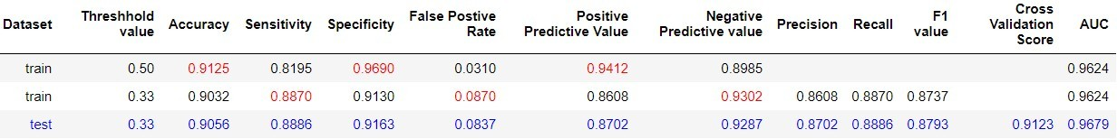
After trying several models, we finally chose a model with the following characteristics:
Using this model, the dependent variable value was predicted as per the following threshold values of Conversion probability:

Slide 18
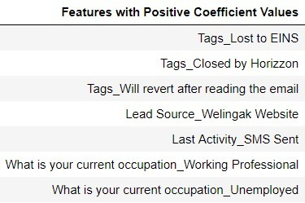
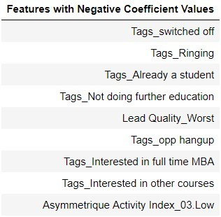
Based on our model, some features are identified which contribute most to a Lead getting converted successfully.
The conversion probability of a lead increases with increase in values of the following features in descending order:
The conversion probability of a lead increases with decrease in values of the following features in descending order:

Slide 19



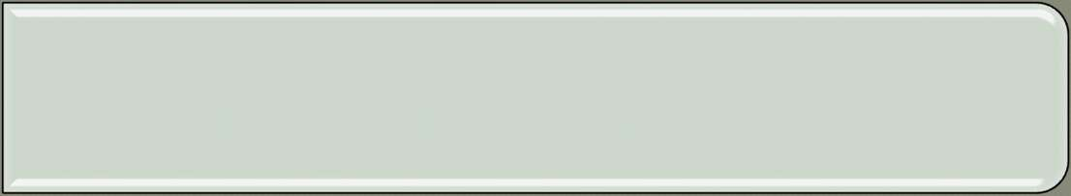


Which are the top three variables in your model that contribute most towards the probability of a lead getting converted?
Tags_Lost to EINS
Tags_Closed by Horizzon
Tags_Will revert after reading the email
What are the top 3 categorical/dummy variables in the model which get maximum focus in order to increase the probability of lead conversion?
Tags_Lost to EINS
Tags_Closed by Horizzon
Tags_Will revert after reading the email
X Education has a period of 2 months every year during which they hire few interns. The sales team, in particular, has around 10 interns allotted to them. So, during this phase, they wish to make the lead conversion more aggressive. So they want almost all of the potential leads (i.e. the customers who have been predicted as 1 by the model) to be converted and hence, want to make phone calls to as much of such people as possible. Suggest a good strategy they should employ at this stage.
We will choose a lower threshold value for Conversion Probability. This will ensure the Sensitivity rating is very high which in turn will make sure almost all leads that are likely to Convert are identified correctly and the agents can make phone calls to as much of such people as possible.
Similarly, at times, the company reaches its target for a quarter before the deadline. During this time, the company wants the sales team to focus on some new work as well. So during this time, the company’s aim is to not make phone calls unless it’s extremely necessary, i.e. they want to minimize the rate of useless phone calls. Suggest a strategy they should employ at this stage.
We will choose a higher threshold value for Conversion Probability. This will ensure the Specificity rating is very high, which in turn will make sure almost all leads that are on the brink of the probability of getting Converted or not are not selected. As a result the agents won’t have to make unnecessary phone calls and can focus on some new work.

Slide 20
THANK YOU

